Slide 1

Supine - team presentation
Zack Hawkins
Josie Wood
Alexander Pritchard
Solomon Cammack

Slide 2

TEAM ROLE INTRODUCTIONS

Slide 3
Zack
Primary Role:
Product Owner
Secondary Role(s):
Secondary Designer
Client Liason

Slide 4
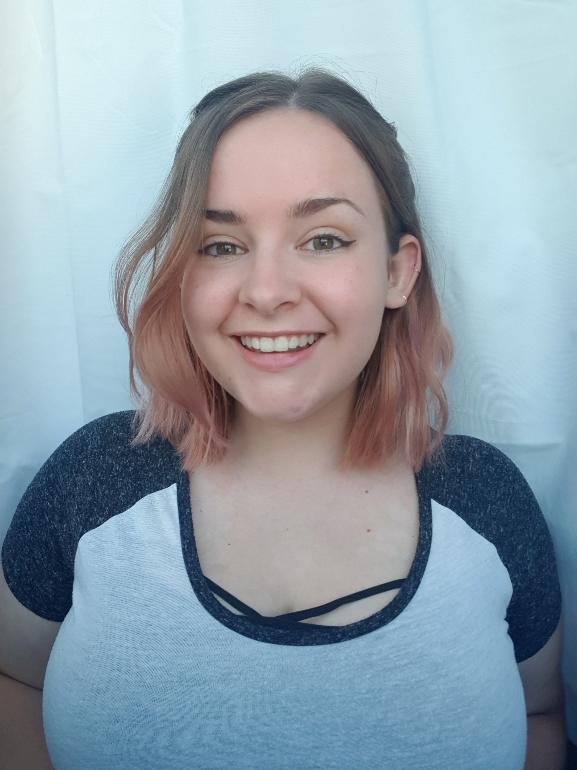
Josie
Primary Role:
Scrum Master
Secondary Role(s):
Lead Designer
QA Tester

Slide 5
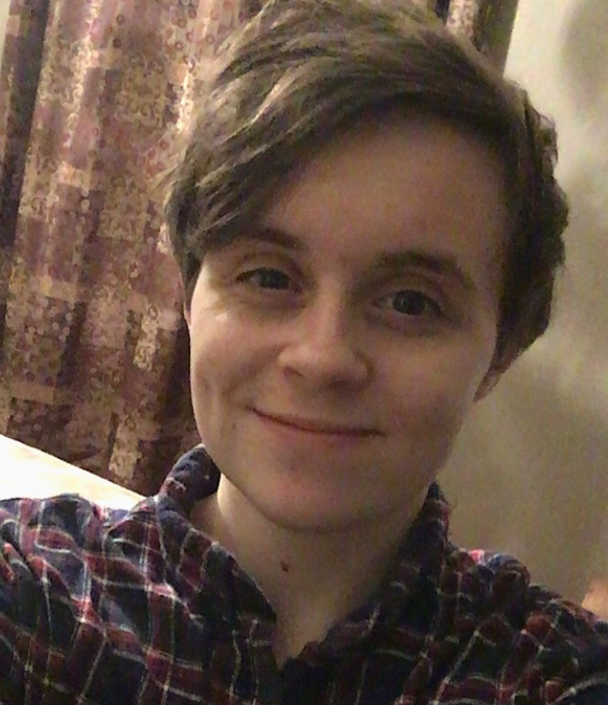
ALEXANDER
Primary Role:
Technical Lead
Secondary Role(s):
Codebase Manager
QA Tester

Slide 6
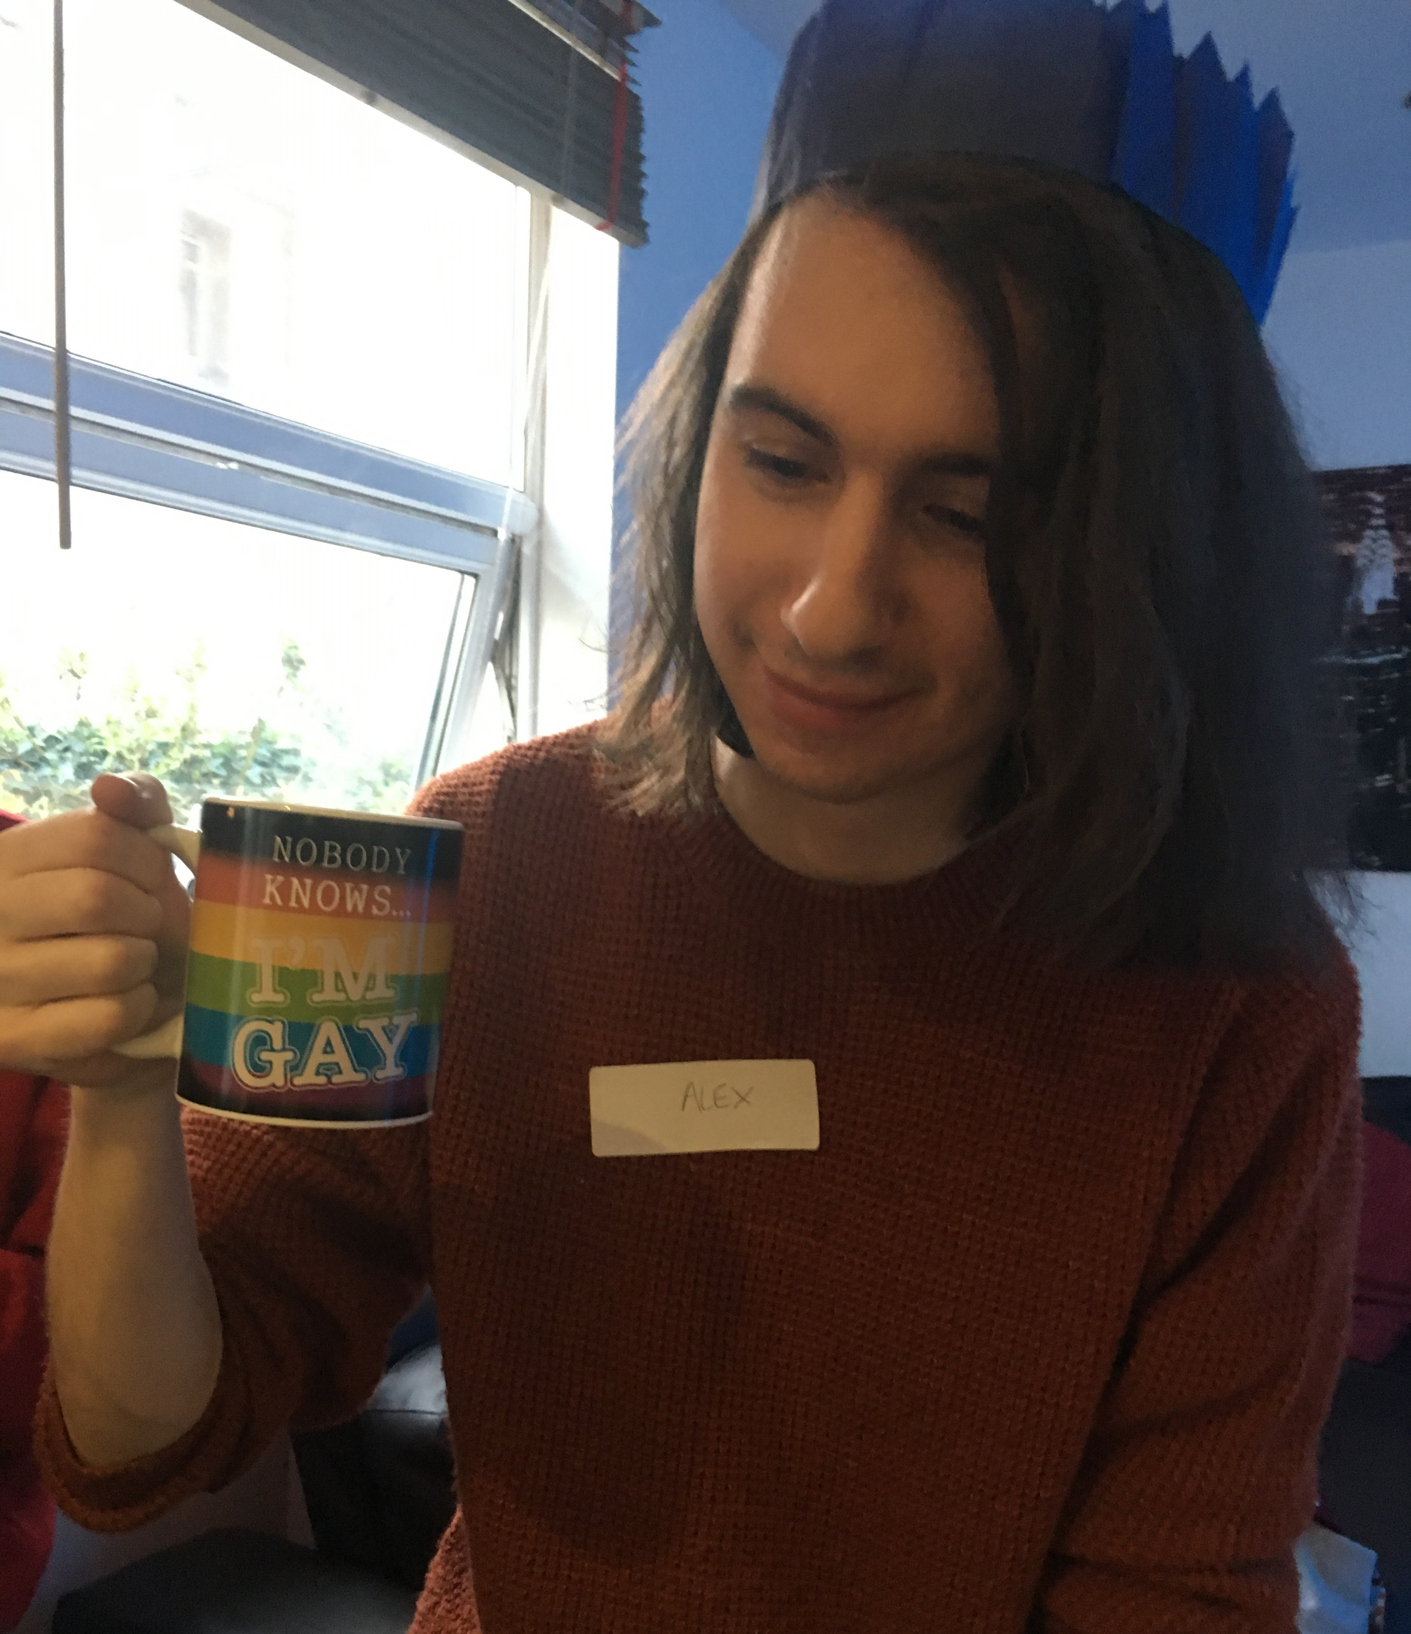
SOLOMON
Primary Role:
Technical Lead
Secondary Role(s):
Repo Manager
Technical Relations Manager

Slide 7
Our client

Slide 8
Communication – with the client

Slide 9
Agreed objectives
Dungeon Crawler game which works as a single player game (game loop isn’t dependant on player 2, can still win or lose without them)
Child can connect to game using a webapp on a tablet with a unique code, like Jackbox games
At least 3 levels of varying difficulty to keep gameplay interesting
Random generation of rooms to vary gameplay
At least 2 variants of enemies, with animations
Webapp has limited text and basic controls so it’s easy for young children to understand
Child-friendly gameplay – no graphic violence

Slide 10
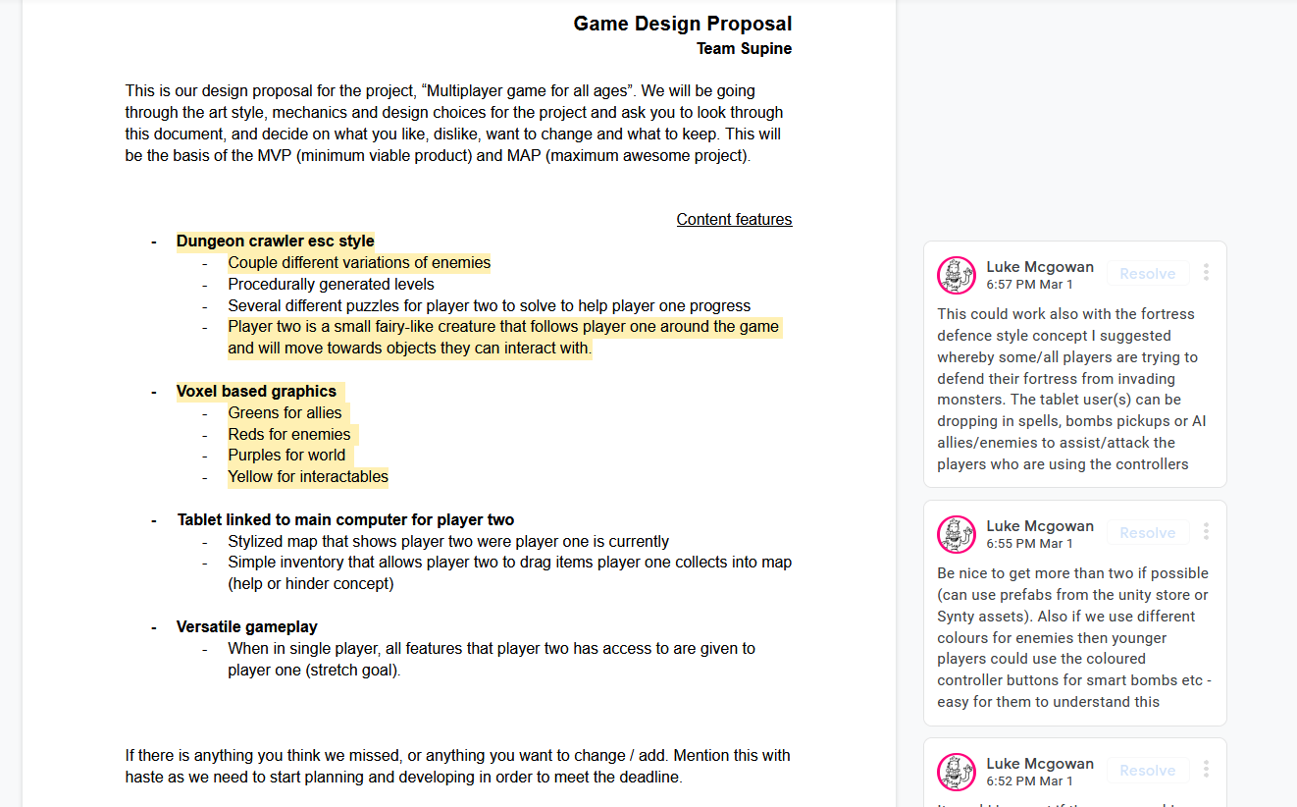
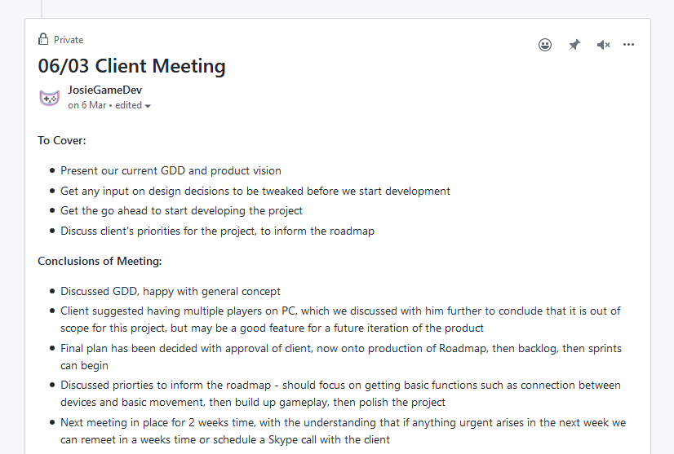
Agile project management
Initial Client Meeting
Product Specification
Roadmap
Development

Slide 11
Development cycle
Sprint planning
Backlog Refinement
Daily Scrum
Testing
Sprint Review

Slide 12
The final product

Slide 13
implementation

Slide 14
implementation [ALEX AND SOLOMON]

Slide 15
testing

Slide 16
Code standards

Slide 17
version control

Slide 18
reflection

Slide 19
links

